Slide 1
Continuous Improvement And Innovation In Agile EA

Slide 2
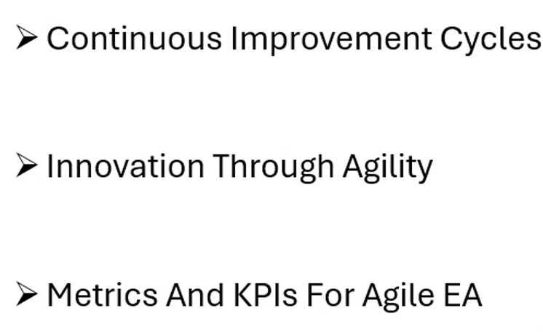

Continuous Improvement And Innovation In Agile EA

Slide 3
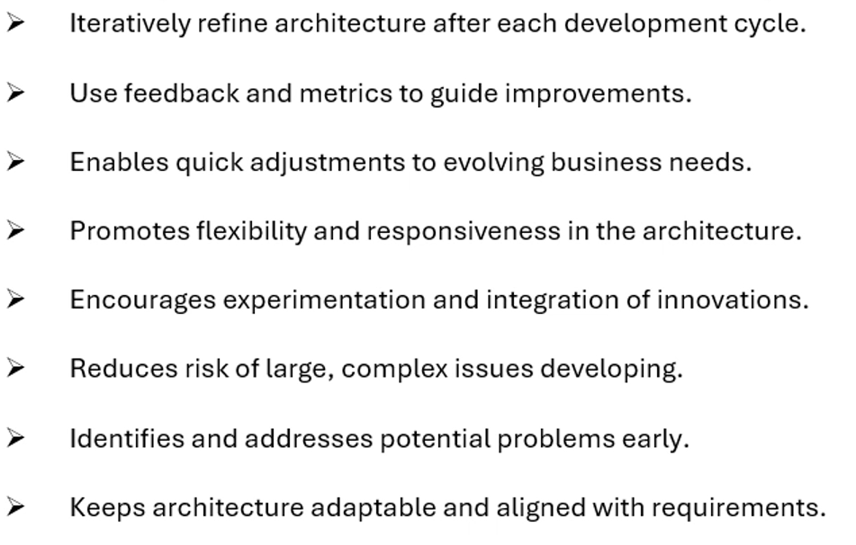
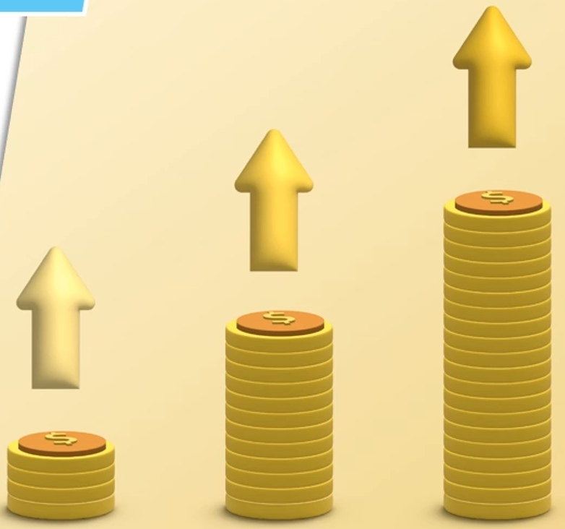
Continuous Improvement Cycles

Slide 4
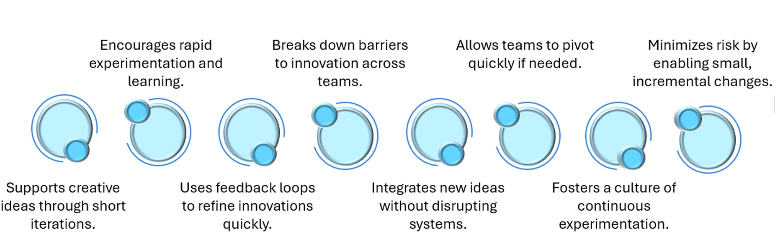
Innovation Through Agility

Slide 5
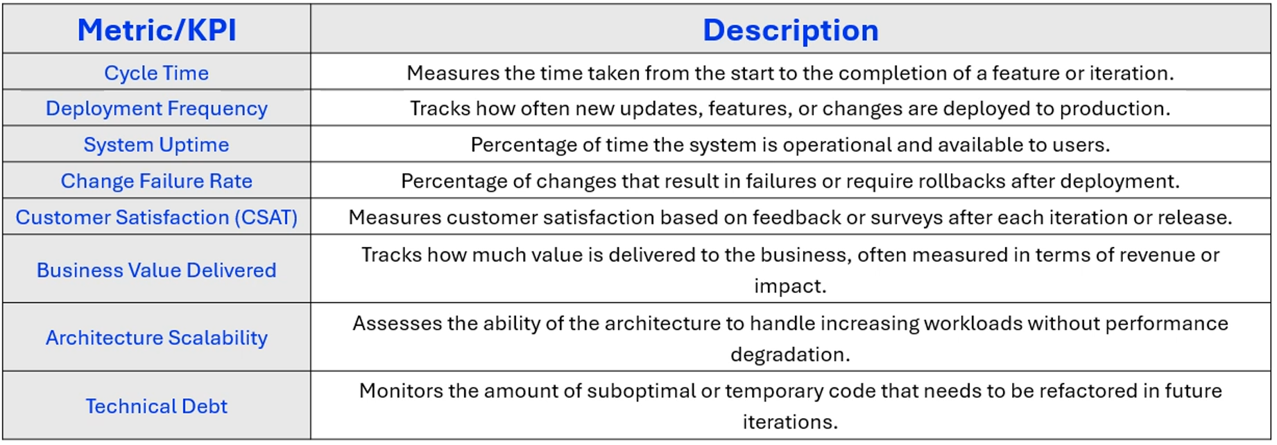
Metrics And KPIs For Agile EA

